Slide 1
Chapter 3
The Efficiency of Algorithms

Slide 2
Learning Objectives
Describe algorithm attributes and why they are important
Explain the purpose of efficiency analysis and apply it to new algorithms to determine the order of magnitude of their time efficiencies
Describe, illustrate, and use the algorithms from the chapter, including: sequential and binary search, selection sort, data cleanup algorithms, pattern-matching
Explain which orders of magnitude grow faster or slower than others
Describe what a “suspected intractable” problem is, giving one or more examples, and the purpose of approximation algorithms that partially solve them

Slide 3
Introduction
What makes one algorithm better than another?
How can we judge and compare algorithms?
Metaphor: purchasing a car vs. attributes of interest
Ease of handling
Style
Fuel efficiency
Ease of understanding
Elegance
Time/space efficiency

Slide 4
Attributes of Algorithms (1 of 3)
Correctness
Is the problem specified correctly?
Does the algorithm produce the correct result?
Example: pattern matching
Problem spec: “given pattern p and text t, determine the location, if any, of pattern p occurring in text t”
Algorithm correct: does it always work?

Slide 5
Attributes of Algorithms (2 of 3)
Ease of understanding: Can somebody other than the author easily understand it?
Examples: Checking correctness and program maintenance
Elegance: using a clever or nonobvious approach
Example: Gauss’s summing of 1 + 2 + … + 100
Attributes may conflict: elegance often conflicts with ease of understanding
Attributes may reinforce each other: ease of understanding supports correctness

Slide 6
Attributes of Algorithms (3 of 3)
Efficiency: an algorithm’s use of time and space resources
Timing an algorithm is not always useful
Confounding factors: machine speed, size of input
Benchmarking: timing an algorithm on standard data sets
Testing hardware and operating system, etc.
Testing real-world performance limits

Slide 7
Measuring Efficiency Sequential Search (1 of 4)
Analysis of algorithms: the study of the efficiency of algorithms
Searching: the task of finding a specific value in a list of values, or deciding it is not there
Sequential search algorithm (from Chapter 2)
Given a target value and a random list of values, find the location of the target in the list, if it occurs, by checking each value in the list in turn

Slide 8
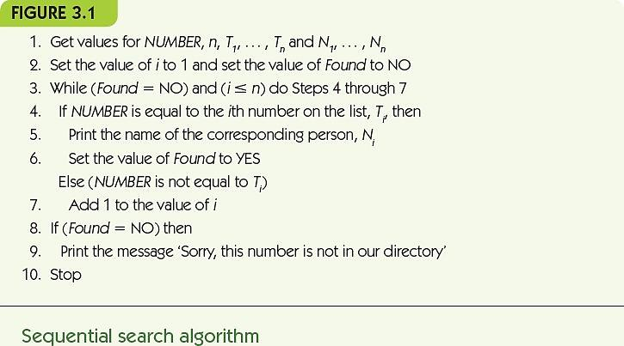
Measuring Efficiency Sequential Search (2 of 4)

Slide 9
Measuring Efficiency Sequential Search (3 of 4)
Central unit of work, operations most important for the task, and occurring frequently
In sequential search, comparison of the target NUMBER to each number in the list
Given a big input list:
Best case is smallest amount of work algorithm does
Worst case is greatest amount of work algorithm does
Average case depends on likelihood of different scenarios occurring

Slide 10
Measuring Efficiency Sequential Search (4 of 4)
Best case: target found with the first comparison
Worst case: target never found or the last value
Average case: if each value is equally likely to be searched, work done varies from 1 to n, averages to n/2
Figure 3.2
Best Case | Worst Case | Average Case
1 | n | n/2
Number of comparisons to find NUMBER in a list of n numbers using sequential search

Slide 11
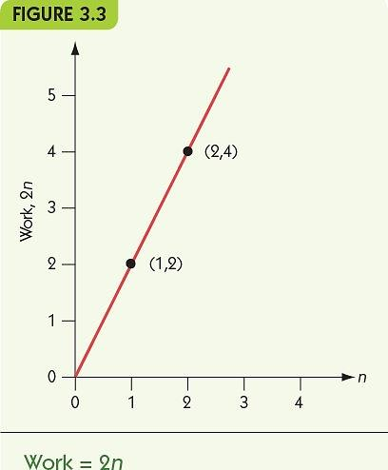
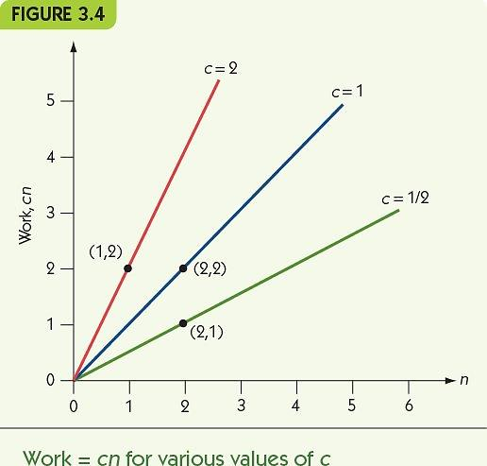
Measuring Efficiency Order of Magnitude—Order n (1 of 2)
Order of magnitude n, Θ(n): the set of functions that grow in a linear fashion

Slide 12
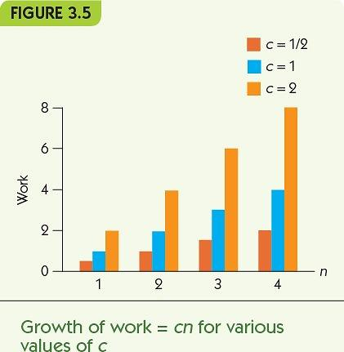
Measuring Efficiency Order of Magnitude—Order n (2 of 2)
Change in growth as n increases is constant size

Slide 13
Measuring Efficiency Selection Sort (1 of 5)
Sorting: the task of putting a list of values into numeric or alphabetical order
Key idea
Pass repeatedly over the unsorted portion of the list
Each pass, select the largest remaining value
Move that value to the end of the unsorted values

Slide 14
Measuring Efficiency Selection Sort (2 of 5)
FIGURE 3.6
Get values for n and the n list items
Set the maker for the unsorted section at the end of the list
While the unsorted section of the list is not empty, do Steps, 4 through 6
Select the largest number in the unsorted section of the list
Exchange this number with the last number in the unsorted section of the list
Move the marker for the unsorted section left one position
Stop
Selection sort algorithm

Slide 15
Measuring Efficiency Selection Sort (3 of 5)
Example: Selection Sort on [5, 1, 3, 9, 4]
Pass 1
Select 9 as the largest in the whole list
Swap with 4 to place in the last slot
[5, 1, 3, 4, 9]
Pass 2
Select 5 as the largest in the first four values
Swap with 4 to place in the last remaining slot
[4, 1, 3, 5, 9]

Slide 16
Measuring Efficiency Selection Sort (4 of 5)
Example: Selection Sort on [5, 1, 3, 9, 4]
Pass 3
Select 4 as the largest in the first three
Swap with 3 to place in the last slot
[3, 1, 4, 5, 9]
Pass 4
Select 3 as the largest in the first two values
Swap with 1 to place in last remaining slot
[1, 3, 4, 5, 9]

Slide 17
Measuring Efficiency Selection Sort (5 of 5)
Central unit of work: hidden in “find largest” step
Work done to find largest changes as unsorted portion shrinks
(n - 1) + (n - 2) + … + 2 + 1 = n (n - 1) / 2
FIGURE 3.7
Length n of List to Sort | n² | Number of Comparisons Required
10 | 100 | 45
100 | 10,000 | 4,950
1,000 | 1,000,000 | 499,500
Comparisons required by selection sort

Slide 18
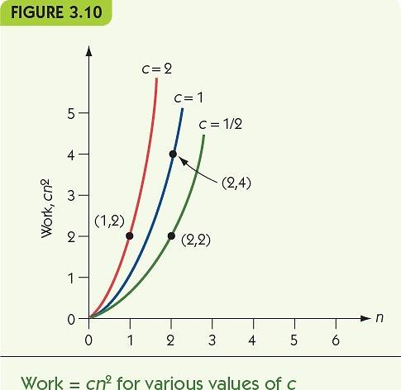
Measuring Efficiency Order of Magnitude—Order n² (1 of 3)
Order of magnitude n², Θ(n²): the set of functions whose growth is on the order of n²

Slide 19
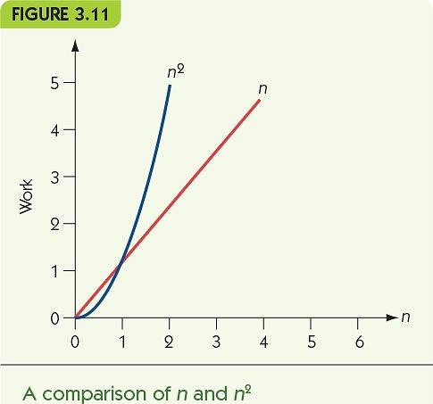
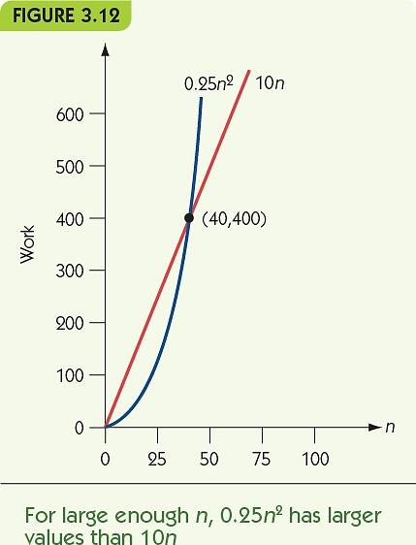
Measuring Efficiency Order of Magnitude—Order n² (2 of 3)
Eventually, every function with order n² has greater values than any function with order n.

Slide 20
Measuring Efficiency Order of Magnitude—Order n² (3 of 3)
FIGURE 3.13
 | Number of Work Units Required: | Number of Work Units Required:
 | Algorithm A | Algorithm B
n | 0.0001 n² | 100n
1,000 | 100 | 100,000
10,000 | 10,000 | 1,000,000
100,000 | 1,000,000 | 10,000,000
1,000,000 | 100,000,000 | 100,000,000
10,000,000 | 10,000,000,000 | 1,000,000,000
A comparison of two extreme Θ(n²) and Θ(n) algorithms

Slide 21
Analysis of Algorithms Data Cleanup Algorithms (1 of 12)
“Given a collection of age data, where erroneous zeros occur, find and remove all the zeros from the data, reporting the number of legitimate age values that remain”
Illustrates multiple solutions to a single problem
Use of analysis to compare algorithms

Slide 22
Analysis of Algorithms Data Cleanup Algorithms (2 of 12)
Shuffle-left algorithm
Search for zeros from left to right
When a zero is found, shift all values to its right one cell to the left
Example: [55, 0, 32, 19, 0, 27]
Finds 0 at position 2: [55, 32, 19, 0, 27, 27]
Finds 0 at position 4: [55, 32, 19, 27, 27, 27]

Slide 23
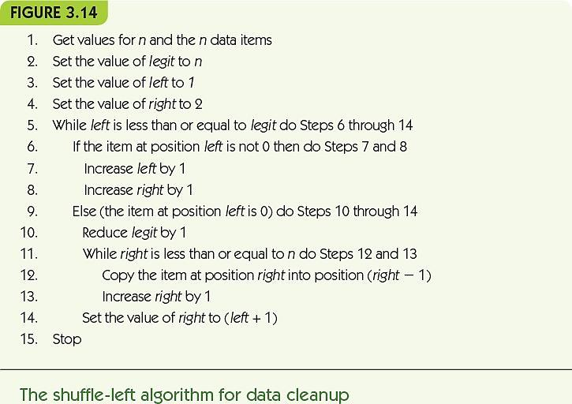
Analysis of Algorithms Data Cleanup Algorithms (3 of 12)

Slide 24
Analysis of Algorithms Data Cleanup Algorithms (4 of 12)
Analysis of shuffle-left for time efficiency
Count comparisons looking for zero AND movements of values
Best case: no zero value, check each value and nothing more: Θ(n)
Worst case: every value is a zero, move n - 1 values, then n - 2 values, etc.: Θ(n²)
Analysis of shuffle-left for space efficiency
Uses no significant space beyond input

Slide 25
Analysis of Algorithms Data Cleanup Algorithms (5 of 12)
Copy-over algorithm
Create a second, initially empty, list
Look at each value in the original
If it is nonzero, copy it to the second list
Example: [55, 0, 32, 19, 0, 27]
answer = [55]
answer = [55]
answer = [55, 32]
answer = [55, 32, 19]
answer = [55, 32, 19]
answer = [55, 32, 19, 27]

Slide 26
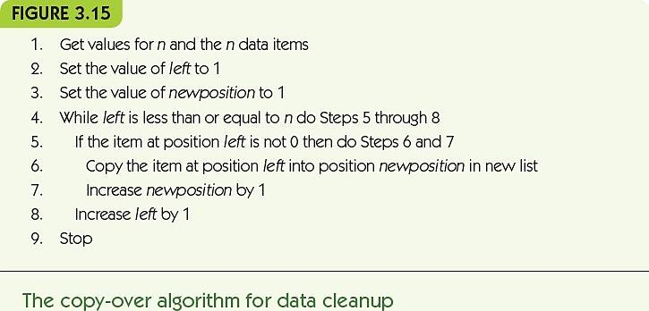
Analysis of Algorithms Data Cleanup Algorithms (6 of 12)

Slide 27
Analysis of Algorithms Data Cleanup Algorithms (7 of 12)
Time efficiency for copy-over
Best case: all zeros, checks each value but doesn’t copy it: Θ(n)
Worst case: no zeros, checks each value and copies it: Θ(n)
Space efficiency for copy-over
Best case: all zeros, uses no extra space
Worst case: no zeros, uses n extra spaces

Slide 28
Analysis of Algorithms Data Cleanup Algorithms (8 of 12)
Converging-pointers algorithm
Keep track of two pointers at the data
Left pointer moves left to right and stops when it sees a zero value
Right pointer stays put until a zero is found
Then its value is copied on top of the zero, and it moves one cell to the left
Stop when the left crosses the right

Slide 29
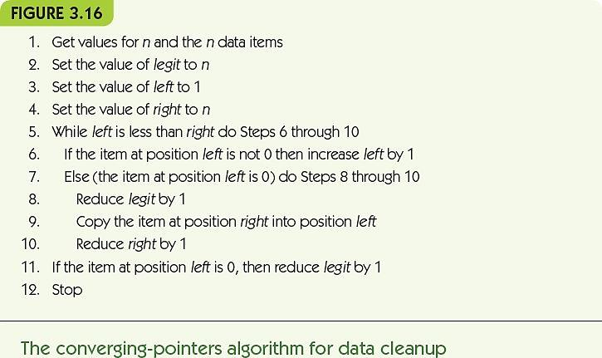
Analysis of Algorithms Data Cleanup Algorithms (9 of 12)

Slide 30
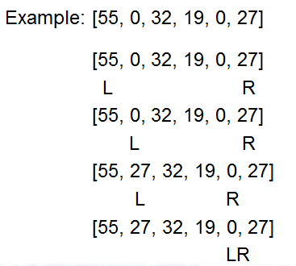
Analysis of Algorithms Data Cleanup Algorithms (10 of 12)

Slide 31
Analysis of Algorithms Data Cleanup Algorithms (11 of 12)
Time efficiency for converging-pointers
Best case: no zeros, left pointer just moves across to pass the right pointers, examines each value: Θ(n)
Worst case: all zeros, examines each value and copies a value over it, right pointer moves left towards left pointer: Θ(n)
Space efficiency for converging-pointers
No significant extra space needed

Slide 32
Analysis of Algorithms Data Cleanup Algorithms (12 of 12)
FIGURE 3.17
 | 1. Shuffle-left: | 1. Shuffle-left: | 2. Copy-over: | 2. Copy-over: | 3.Converging-pointers: | 3.Converging-pointers:
 | Time | Space | Time | Space | Time | Space
Best case | Θ(n) | n | Θ(n) | n | Θ(n) | n
Worst case | Θ(n²) | n | Θ(n) | 2n | Θ(n) | n
Average case | Θ(n²) | n | Θ(n) | n ≤ x ≤ 2n | Θ(n) | n
Analysis of three data cleanup algorithms

Slide 33
Analysis of Algorithms Binary Search (1 of 5)
Binary Search Algorithm
Requires the list to be ordered values. Will find the location of the target in the list, if it occurs, by starting in the middle and splitting the range in two with each comparison

Slide 34
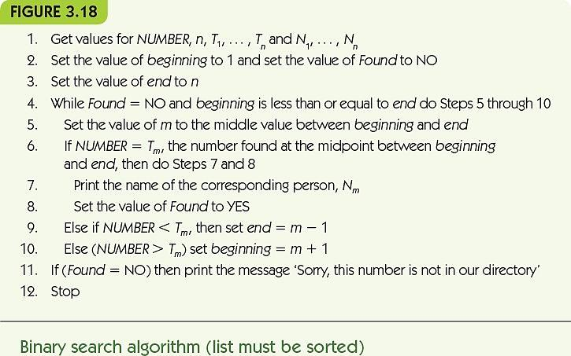
Analysis of Algorithms Binary Search (2 of 5)

Slide 35
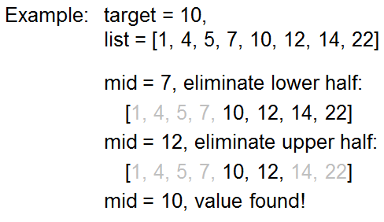
Analysis of Algorithms Binary Search (3 of 5)

Slide 36
Analysis of Algorithms Binary Search (4 of 5)
Central unit of work: comparisons against target
Best case efficiency
Value is the first middle value: 1 comparison
Worst case efficiency
Value does not appear, repeats as many times as we can divide the list before running out of values: Θ(lg n)

Slide 37
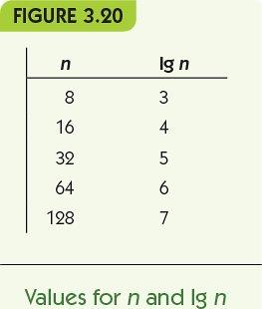
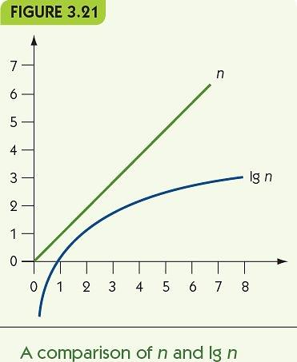
Analysis of Algorithms Binary Search (5 of 5)
Order of magnitude lg n, Θ(lg n), grows very slowly

Slide 38
Analysis of Algorithms Pattern Matching (1 of 4)
Algorithm from Chapter 2: Finding a pattern in a text document
Best case: when first symbol of pattern does not appear in text
Worst case: when all but last symbol of pattern make up the text

Slide 39
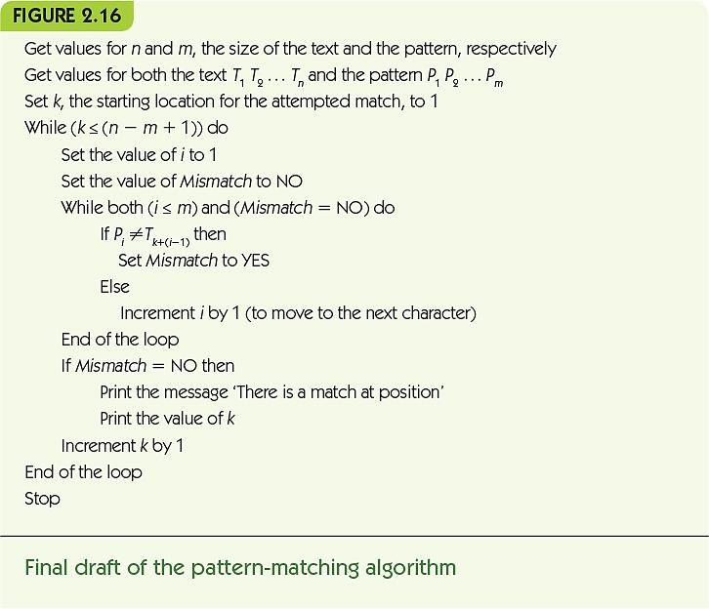
Analysis of Algorithms Pattern Matching (2 of 4)

Slide 40
Analysis of Algorithms Pattern Matching (3 of 4)
Best case example
Pattern = “xyz” text = “aaaaaaaaaaaaaaa”
At each step, compare x to a and then move on
Θ(n) comparisons
Worst case example
Pattern = “aab” text = “aaaaaaaaaaaaaaa”
At each step, compare m symbols from pattern against text before moving on
Θ(m × n) comparisons

Slide 41
Analysis of Algorithms Pattern Matching (4 of 4)
FIGURE 3.22
Problem | Unit of Work | Algorithm | Best Case | Worst Case | Average Case
Searching | Comparisons | Sequential search | 1 | Θ(n) | Θ(n)
Searching | Comparisons | Binary search | 1 | Θ(Ig n) | Θ(Ig n)
Sorting | Comparisons and exchanges | Selection sort | Θ(n²)
Data cleanup | Examinations and copies | Shuffle-left | Θ(n) | Θ(n²) | Θ(n²)
Data cleanup | Examinations and copies | Copy-over | Θ(n) | Θ(n²) | Θ(n²)
Data cleanup | Examinations and copies | Converging-pointers | Θ(n) | Θ(n) | Θ(n)
Pattern matching | Character comparisons | Forward march | Θ(n) | Θ(m × n)
Order-of-magnitude time efficiency summary

Slide 42
When Things Get Out of Hand (1 of 8)
Polynomially bounded: an algorithm that does work on the order of Θ(n^{k})
Most common problems are polynomially bounded
Hamiltonian circuit is NOT
Given a graph, find a path that passes through each vertex exactly once and returns to its starting point

Slide 43
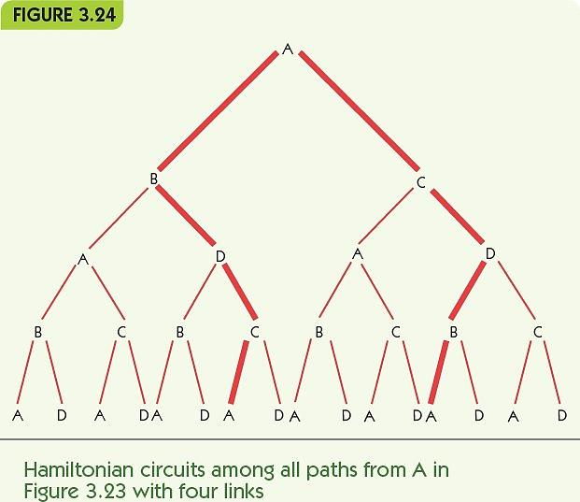
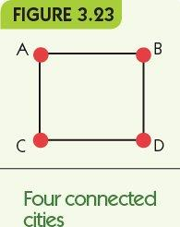
When Things Get Out of Hand (2 of 8)

Slide 44
When Things Get Out of Hand (3 of 8)
Possible paths in the graph are paths through a tree of choices
Simplest case has exactly two choices per vertex
Number of paths to examine = number of leaves in the tree
Height of the tree = n + 1 (n is the number of vertices in the graph)
Number of leaves = 2^{n}

Slide 45
When Things Get Out of Hand (4 of 8)
Exponential algorithm: an algorithm whose order of growth is Θ(2^{n})
Intractable: problems with no polynomially bounded solutions
Hamiltonian circuit
Traveling salesperson
Bin packing
Chess

Slide 46
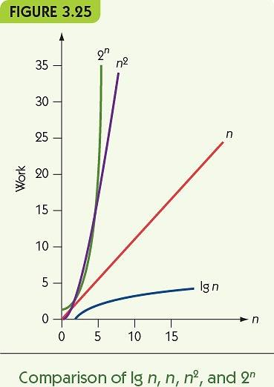
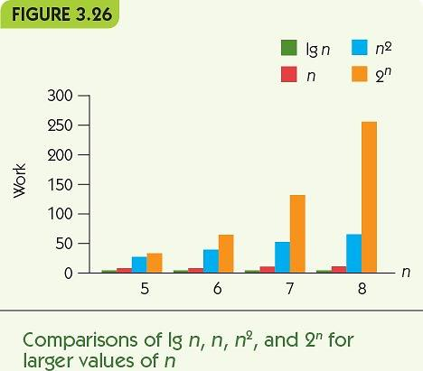
When Things Get Out of Hand (5 of 8)

Slide 47
When Things Get Out of Hand (6 of 8)
FIGURE 3.27
Order | 10 | 50 | n 100 | 1,000
Ig n | 0.0003 sec | 0.0006 sec | 0.0007 sec | 0.001 sec
n | 0.001 sec | 0.005 sec | 0.01 sec | 0.1 sec
n² | 0.01 sec | 0.25 sec | 1 sec | 1.67 min
2^{n} | 0.1024 sec | 3,570 years | 4 × 10¹⁶ centuries | Too big to compute!!
A comparison of four orders of magnitude

Slide 48
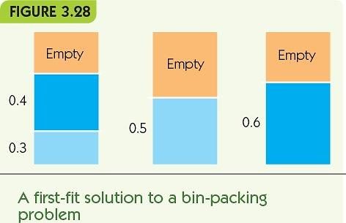
When Things Get Out of Hand (7 of 8)

Slide 49
When Things Get Out of Hand (8 of 8)
Approximation algorithms: algorithms that partially solve, or provide suboptimal solutions to, intractable problems
Example: bin packing
For each box to be packed:
Check each current bin
If new box fits in the bin, place it there
If no bin can hold the new box, add a new bin

Slide 50
Summary
We must evaluate the quality of algorithms and compare competing algorithms to each other
Attributes: correctness, efficiency, elegance, and ease of understanding
Compare competing algorithms for time and space efficiency (time/space tradeoffs are common)
Orders of magnitude capture work as a function of input size: Θ(lg n), Θ(n), Θ(n²), and Θ(2^{n})
Problems with only exponential algorithms are intractable

